Slide 1


10 Machine Learning things every .NET Developer should know
Bahrudin Hrnjica,PhD, MVP,
@bhrnjica, daenet

Slide 2
Agenda
Machine Learning
Project
10. Update and Tuning
Data Collection Preparation
Model Implementation
9. Model Deployment
Problem understanding
Data Understanding
Data Preparation
6. Model Training
7. Model Validation
Delivery
Feature Selection
5. Building/Configuring prediction model
8. Model Testing

Slide 3
1. Problem understanding
What process is behind the data.
What process components are involved
How data is collected
Any data can be of help
Example: The Iris Data Set
http://en.wikipedia.org/wiki/Iris_flower_data_set

Slide 4


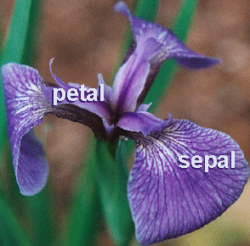
1. Problem understanding

Slide 5
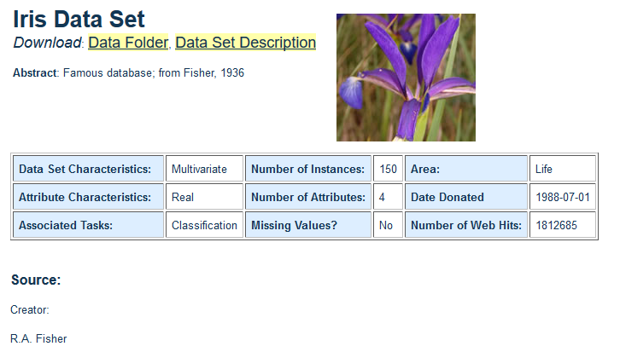
2. Data understanding
https://archive.ics.uci.edu/ml/datasets/iris

Slide 6
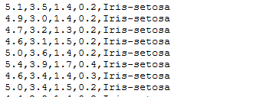
2. Data understanding
Metadata
https://archive.ics.uci.edu/ml/machine-learning-databases/iris/iris.names
Data values
https://archive.ics.uci.edu/ml/machine-learning-databases/iris/iris.data

Slide 7
3. Data Preparation
Provide data in suitable format
Provide quick overview of the data
Identification od column types
Missing value handling

Slide 8
4. Feature Selection
Data identification
What are features(predictors)
What is label (output variable)
Feature Selection Algorithms
filter methods,
wrapper methods and
embedded methods.
Data Scaling
Normalization
Standardization
Column derivation
Creating new column from existing
Notes:
Feature selection methods aid you in your mission to create an accurate predictive model. They help you by choosing features that will give you as good or better accuracy whilst requiring less data.
Feature selection methods can be used to identify and remove unneeded, irrelevant and redundant attributes from data that do not contribute to the accuracy of a predictive model or may in fact decrease the accuracy of the model.
Fewer attributes is desirable because it reduces the complexity of the model, and a simpler model is simpler to understand and explain.

Slide 9
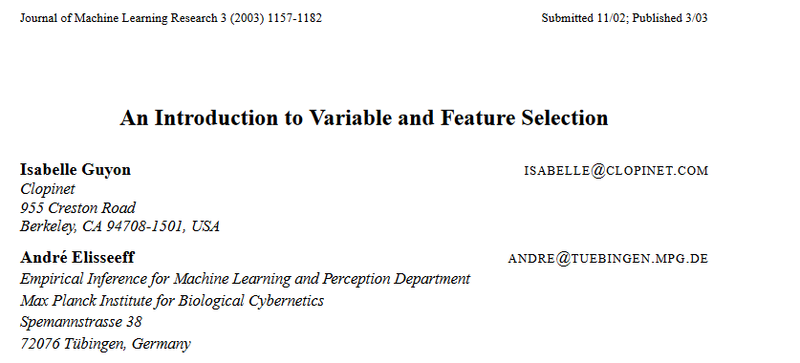
4. Feature Selection

Slide 10
4. Feature Selection
Do you have domain knowledge?
If yes, construct a better set of ad hoc”” features
Are your features commensurate?
If no, consider normalizing them.
Do you suspect interdependence of features?
If yes, expand your feature set by constructing conjunctive features or products of features, as much as your computer resources allow you.
Do you need to prune the input variables (e.g. for cost, speed or data understanding reasons)?
If no, construct disjunctive features or weighted sums of feature
Do you need to assess features individually (e.g. to understand their influence on the system or because their number is so large that you need to do a first filtering)?
If yes, use a variable ranking method; else, do it anyway to get baseline results.
Do you need a predictor?
If no, stop
Do you suspect your data is “dirty” (has a few meaningless input patterns and/or noisy outputs or wrong class labels)?
If yes, detect the outlier examples using the top ranking variables obtained in step 5 as representation; check and/or discard them.
Do you know what to try first?
If no, use a linear predictor.
If yes, try a non-linear predictor with that subset.
Do you have new ideas, time, computational resources, and enough examples?
If yes, compare several feature selection methods, including your new idea, correlation coefficients, backward selection and embedded methods. Use linear and non-linear predictors. Select the best approach with model selection
Do you want a stable solution (to improve performance and/or understanding)? If yes, subsample your data and redo your analysis for several “bootstrap”.
Notes:
Commensurate - proporcionalan

Slide 11
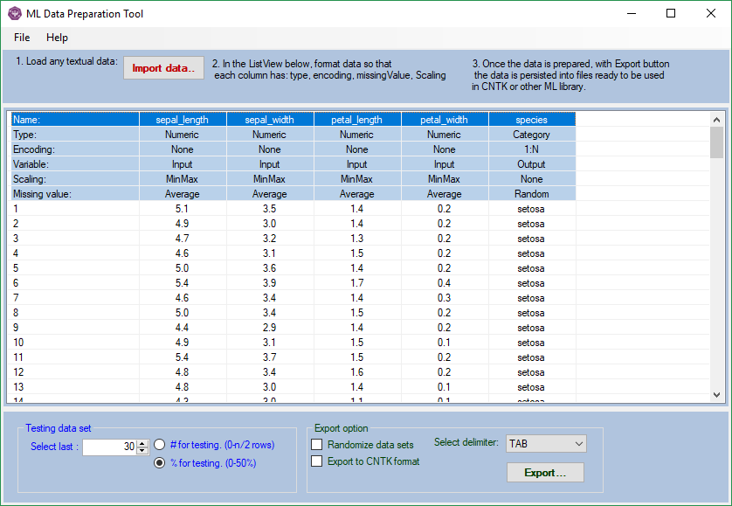
ML Data Preparation Tool
An easy way to prepare your data

Slide 12
5. Building/Config. prediction model
Build
Train
Test
Predict
Providing data, defining input and output, network and training configuration
Use training data set to build NN model, often 70% of provided data
Use your remaining data set (30%) to validate NN model.
Once training and evaluation process are successfully done, use the model in production, to make prediction.

Slide 13
6. Model Training
Configuration on any ML Algorithm
Input dimension
Output dimension
Data reader type
Samples number
Learning Type (Offline, Online, Minibatching)
Algorithm Configuration (Parameters)
Training Type

Slide 14
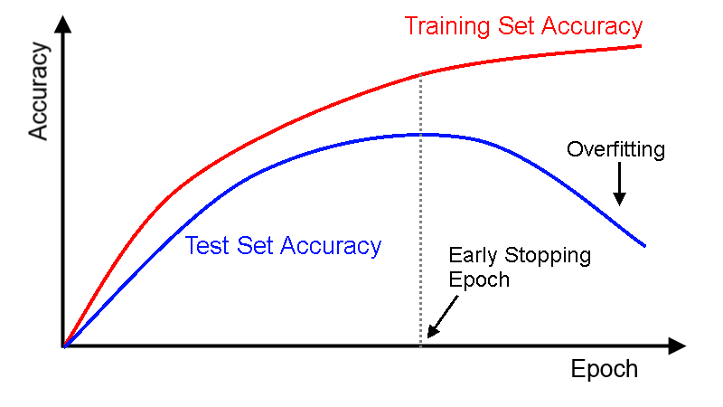
7. Model Validation

Slide 15
8. Model Testing
Testing ML model with completely new data
Perform Model Evaluation
Decision if model is ready for production

Slide 16
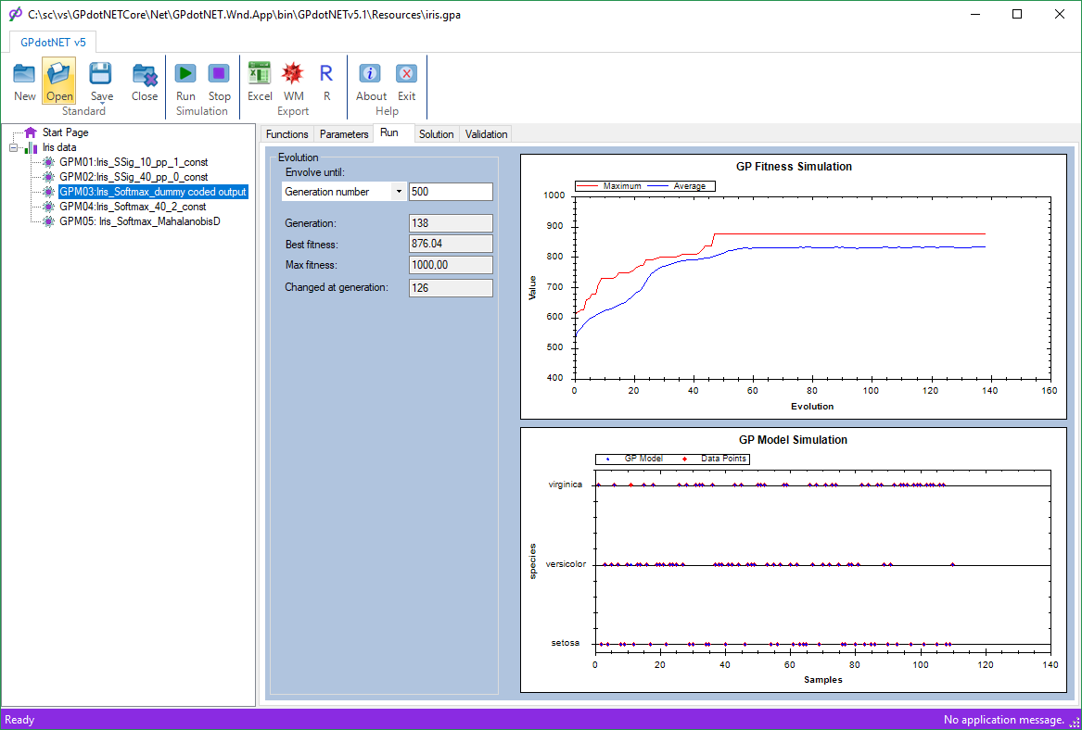
GPdotNET- genetic programming with .NET
GPdotNET Iris classification with GP ML algorithm

Slide 17
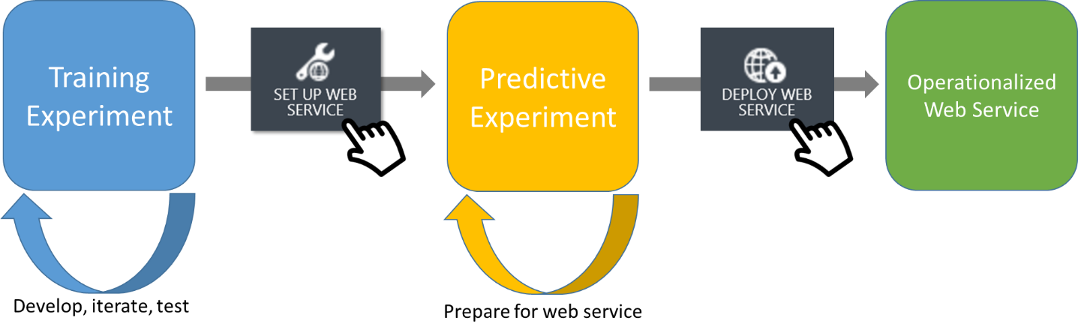
9. Model Deployment

Slide 18
10. Monitoring and model improvements
Adding new data into data set
Performing retraining
Improving User experience

Slide 19

References
Book: Optimized GP Applications https://goo.gl/38jzT9
http://github/microsoft/cntk - CNTK on GitHub,
https://github.com/bhrnjica/gpdotnet - Machine Learning with Genetic Programming,
http://github.com/bhrnjica/anndotnet - GUI tool for running CNTK,
https://github.com/bhrnjica/ - my GitHub repositories

Slide 20
Q&A

Slide 21
Good to know
Machine learning means learning from data; AI is a buzzword
Machine learning is about data and algorithms, but mostly data.
Unless you have a lot of data, you should stick to simple models.
Machine learning can only be as good as the data you use to train it.
Machine learning only works if your training data is representative.
Most of the hard work for machine learning is data transformation.
Deep learning is a revolutionary advance, but it isn’t a magic bullet.
Machine learning systems are highly vulnerable to operator error.
Machine learning can inadvertently create a self-fulfilling prophecy.
Machine learning can inadvertently create a self-fulfilling prophecy.
Notes:
As someone who often finds himself explaining machine learning to non-experts, I offer the following list as a public service announcement.
1. Machine learning means learning from data; AI is a buzzword. Machine learning lives up to the hype: there are an incredible number of problems that you can solve by providing the right training data to the right learning algorithms. Call it AI if that helps you sell it, but know that AI is a buzzword that can mean whatever people want it to mean.
2. Machine learning is about data and algorithms, but mostly data. There’s a lot of excitement about advances in machine learning algorithms, and particularly about deep learning. But data is the key ingredient that makes machine learning possible. You can have machine learning without sophisticated algorithms, but not without good data.
3. Unless you have a lot of data, you should stick to simple models. Machine learning trains a model from patterns in your data, exploring a space of possible models defined by parameters. If your parameter space is too big, you’ll overfit to your training data and train a model that doesn’t generalize beyond it. A detailed explanation requires more math, but as a rule you should keep your models as simple as possible.
4. Machine learning can only be as good as the data you use to train it. The phrase “garbage in, garbage out” predates machine learning, but it aptly characterizes a key limitation of machine learning. Machine learning can only discover patterns that are present in your training data. For supervised machine learning tasks like classification, you’ll need a robust collection of correctly labeled, richly featured training data.
5. Machine learning only works if your training data is representative. Just as a fund prospectus warns that “past performance is no guarantee of future results”, machine learning should warn that it’s only guaranteed to work for data generated by the same distribution that generated its training data. Be vigilant of skews between training data and production data, and retrain your models frequently so they don’t become stale.
6. Most of the hard work for machine learning is data transformation. From reading the hype about new machine learning techniques, you might think that machine learning is mostly about selecting and tuning algorithms. The reality is more prosaic: most of your time and effort goes into data cleansing and feature engineering — that is, transforming raw features into features that better represent the signal in your data.
7. Deep learning is a revolutionary advance, but it isn’t a magic bullet. Deep learning has earned its hype by delivering advances across a broad range of machine learning application areas. Moreover, deep learning automates some of the work traditionally performed through feature engineering, especially for image and video data. But deep learning isn’t a silver bullet. You can’t just use it out of the box, and you’ll still need to invest significant effort in data cleansing and transformation.
8. Machine learning systems are highly vulnerable to operator error. With apologies to the NRA, “Machine learning algorithms don’t kill people; people kill people.” When machine learning systems fail, it’s rarely because of problems with the machine learning algorithm. More likely, you’ve introduced human error into the training data, creating bias or some other systematic error. Always be skeptical, and approach machine learning with the discipline you apply to software engineering.
9. Machine learning can inadvertently create a self-fulfilling prophecy. In many applications of machine learning, the decisions you make today affect the training data you collect tomorrow. Once your machine learning system embeds biases into its model, it can continue generating new training data that reinforces those biases. And some biases can ruin people’s lives. Be responsible: don’t create self-fulfilling prophecies.
10. AI is not going to become self-aware, rise up, and destroy humanity. A surprising number of people (cough) seem to be getting their ideas about artificial intelligence from science fiction movies. We should be inspired by science fiction, but not so credulous that we mistake it for reality. There are enough real and present dangers to worry about, from consciously evil human beings to unconsciously biased machine learning models. So you can stop worrying about SkyNet and “superintelligence”.
There’s far more to machine learning than I can explain in a top-10 list. But hopefully this serves as a useful introduction for non-experts.

